Slide 1
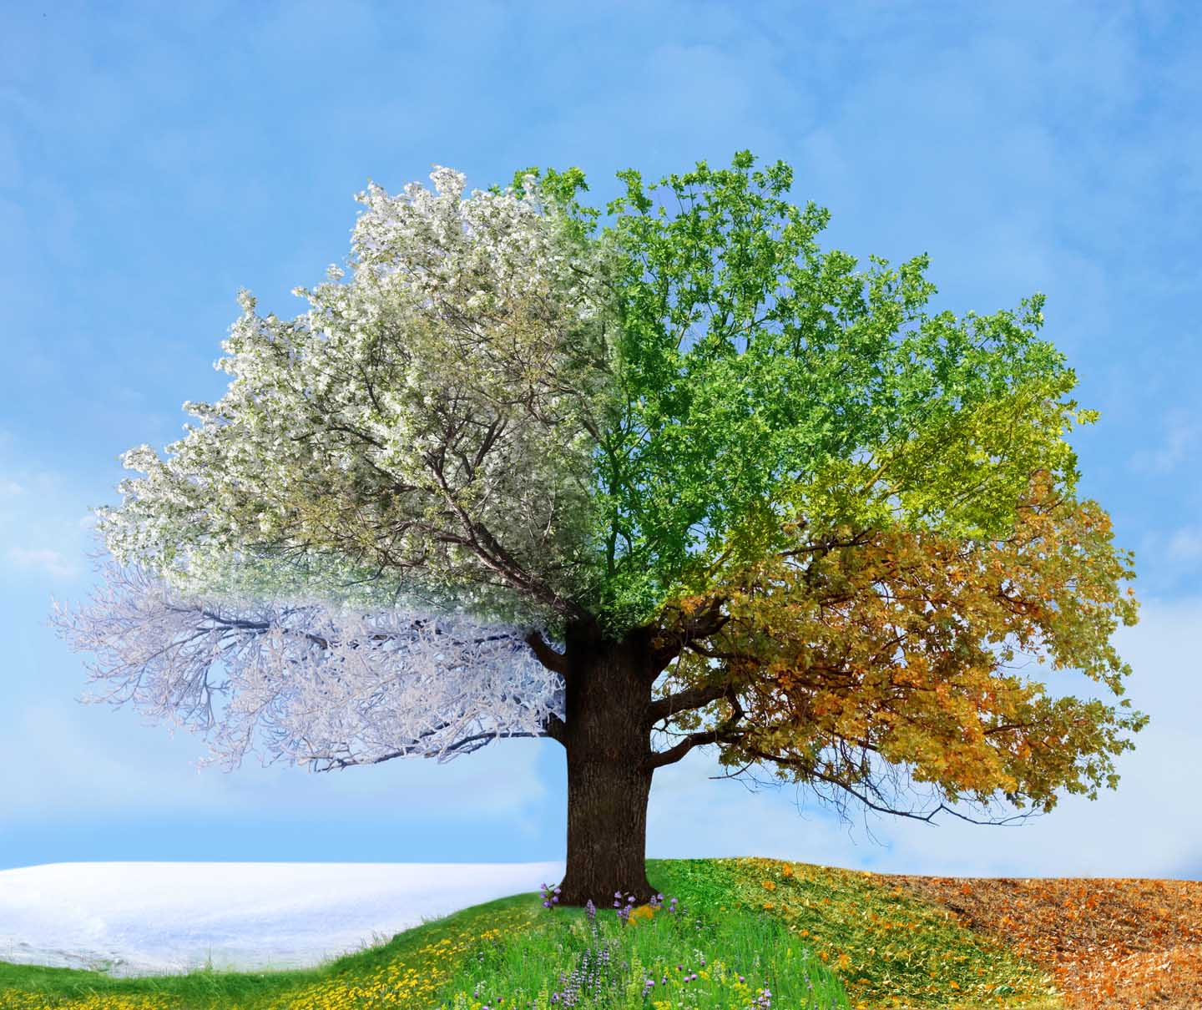
Seasons and Weather
Pictures from Google Images

Slide 2
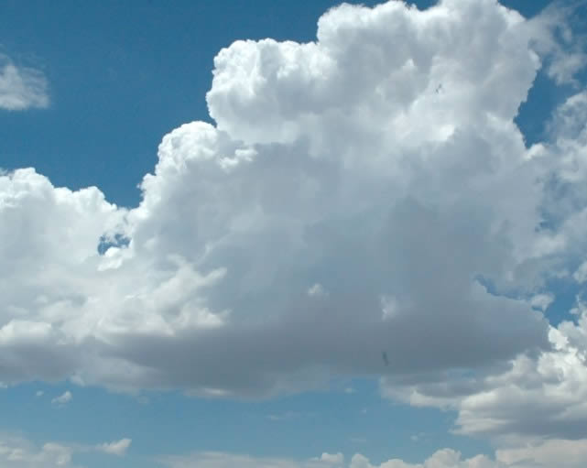
Weather changes from day to day, but it can be predictable during a season.

Slide 3
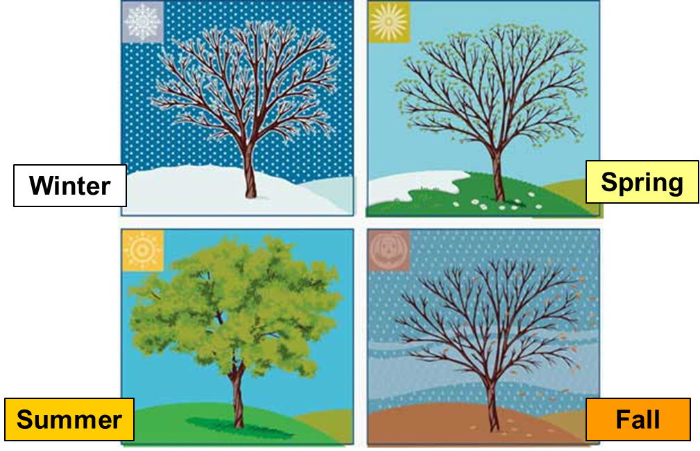
There are four seasons in a year - winter, spring, summer, and fall. The weather changes during each season. In each season, you can expect a certain type of weather.
Four Seasons
Weather changes from day to day, but it can be predictable during a season.

Slide 4
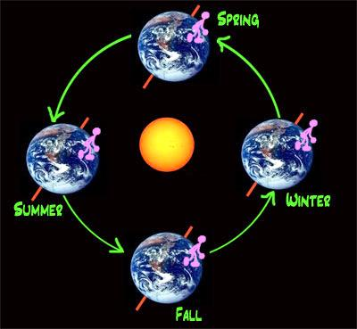
Every season has its own type of weather. Seasons follow one another in a cycle. The change in each season is due to the earth revolving around the sun.
Weather changes from day to day, but it can be predictable during a season.

Slide 5
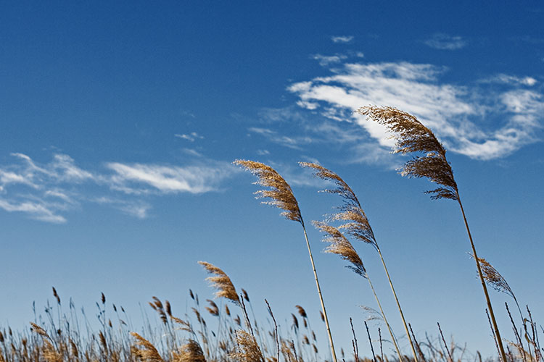
But each day, the weather can be different. The air around the earth is moving all the time. This moving air is called wind. Wind can blow clouds and storms across the sky, changing the weather.
Wind and Weather
Wind brings in clouds.
Weather changes from day to day, but it can be predictable during a season.

Slide 6
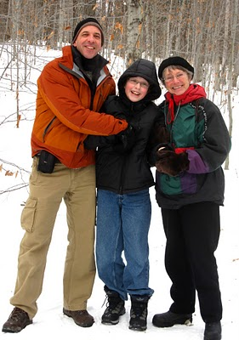
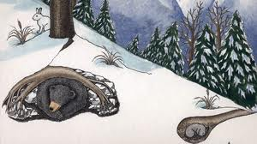
Winter is the coldest season. The days are shorter and the nights are longer. People need to dress warmly in order to protect themselves from the colder air. It snows in many places. So trees are bare, without leaves. Some animals hibernate, while others migrate to warmer places.
Winter
Weather changes from day to day, but it can be predictable during a season.

Slide 7
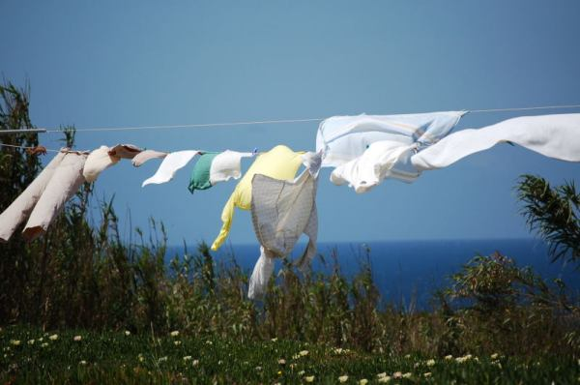
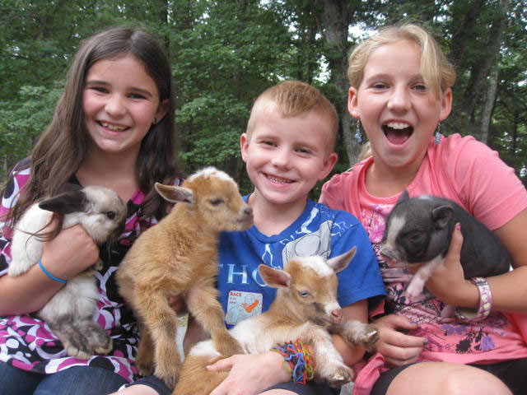
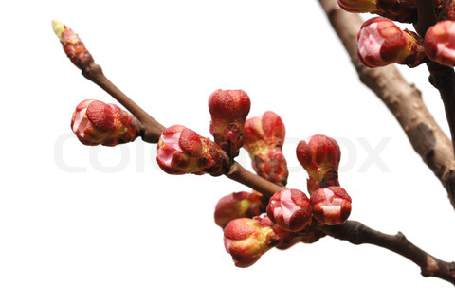
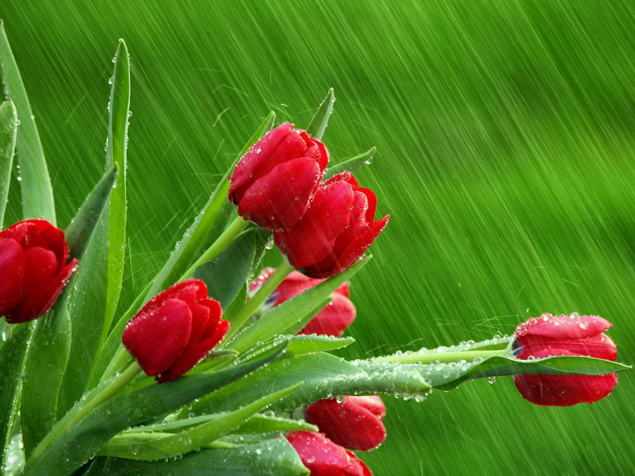
Spring is a warmer season. The days get a little longer, and the nights get shorter. There are more sunny days. There can be breezy days, rainy days, or foggy days. Leaves and buds appear on trees again. Baby animals are born. People begin to spend more time outside.
Spring
Weather changes from day to day, but it can be predictable during a season.

Slide 8
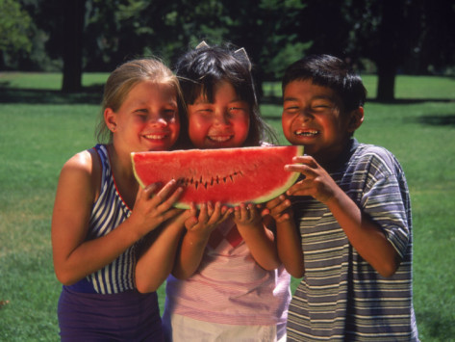
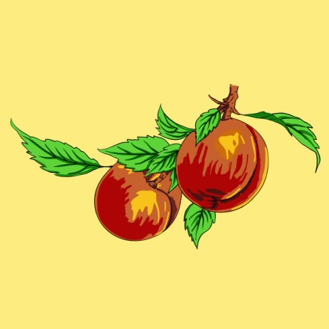
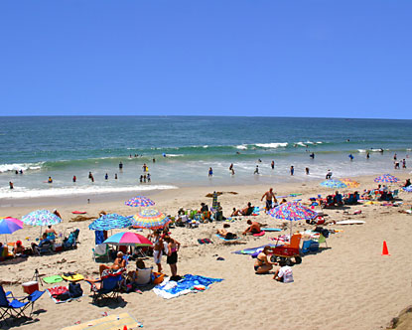
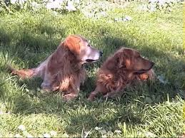
Summer is the hottest season. The days are very long and the nights are short. There are many hot, scorching days. People like to go to a pool or the beach. Animals try to stay cool in the shade. Some fruits and vegetables begin to ripen on trees and plants.
Summer
Weather changes from day to day, but it can be predictable during a season.

Slide 9
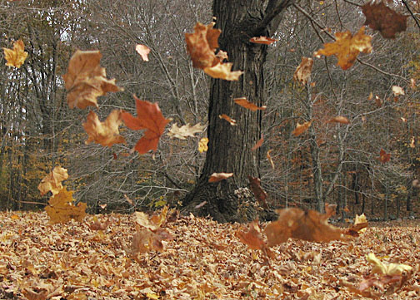
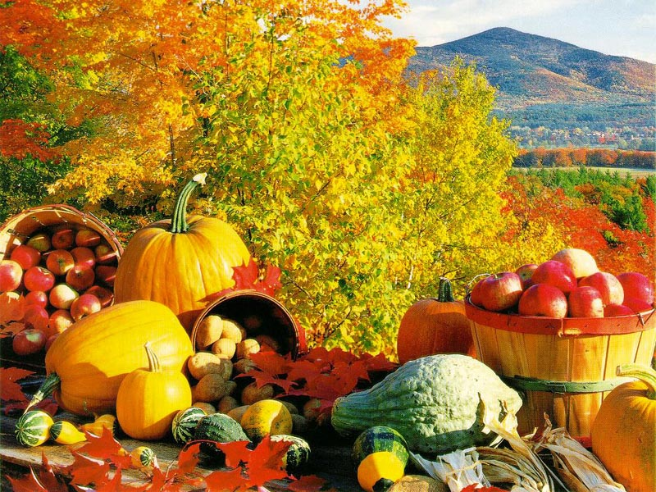
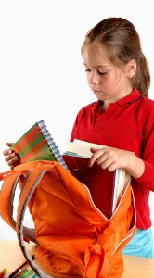
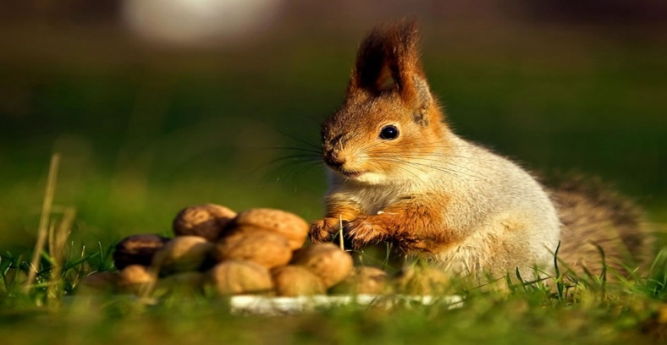
Fall is a cool season. The days get shorter and the nights get longer. There are more windy days. There are more rainy days. People need to dress for the chilly weather. Apples, pumpkins and corn are harvested. The animals prepare for winter and students prepare for school.
Fall
Weather changes from day to day, but it can be predictable during a season.

Slide 10
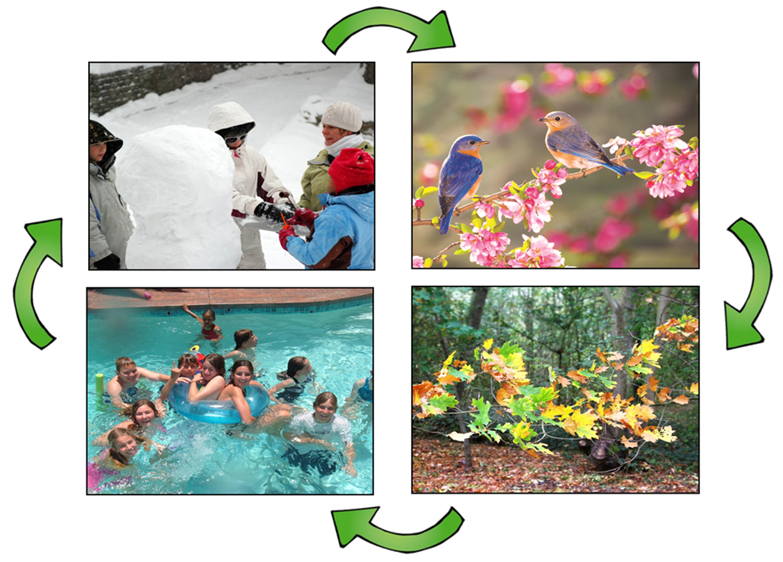
What happens when fall is over? The cycle begins again. Can you predict what will happen in winter? In the spring? In the summer? In the fall? Do you remember the predictable weather for each season?
Changing Seasons
Weather changes from day to day, but it can be predictable during a season.

